Slide 1
8 Steps to successful testing

Slide 2
8 Steps to successful testing
Understand the roles
Identify software or medium to track defects
Set up chosen medium and create instructions
Create base test workbook
Create test cases (for integration and system testing)
Create test scenarios (for user acceptance testing)
Execute testing phases
Gain business approval

Slide 3
1.) Understand roles
Is there a Quality Assurance team?
Who from the business will be testing?
Are there others from the Project Team that will be involved?
What testing phases will you be responsible for?
Who is doing the defect management?

Slide 4
2.) Identify defect tracking software / medium
Regularly Available Software:
Excel
SharePoint
Other Software Options:
Bugzilla
Mantis
Redmine
YouTrack
Pivotal Tracker

Slide 5
3.) Set up chosen software / medium
Set up the project (as applicable)
Ensure it is accessible
Make a simple specifications document
What it is
What it means
Process to use
Create user instructions
Defect logging
Retesting

Slide 6
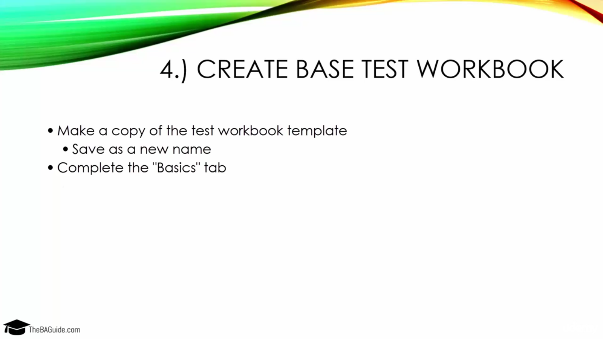
4.) Create base test workbook

Slide 7
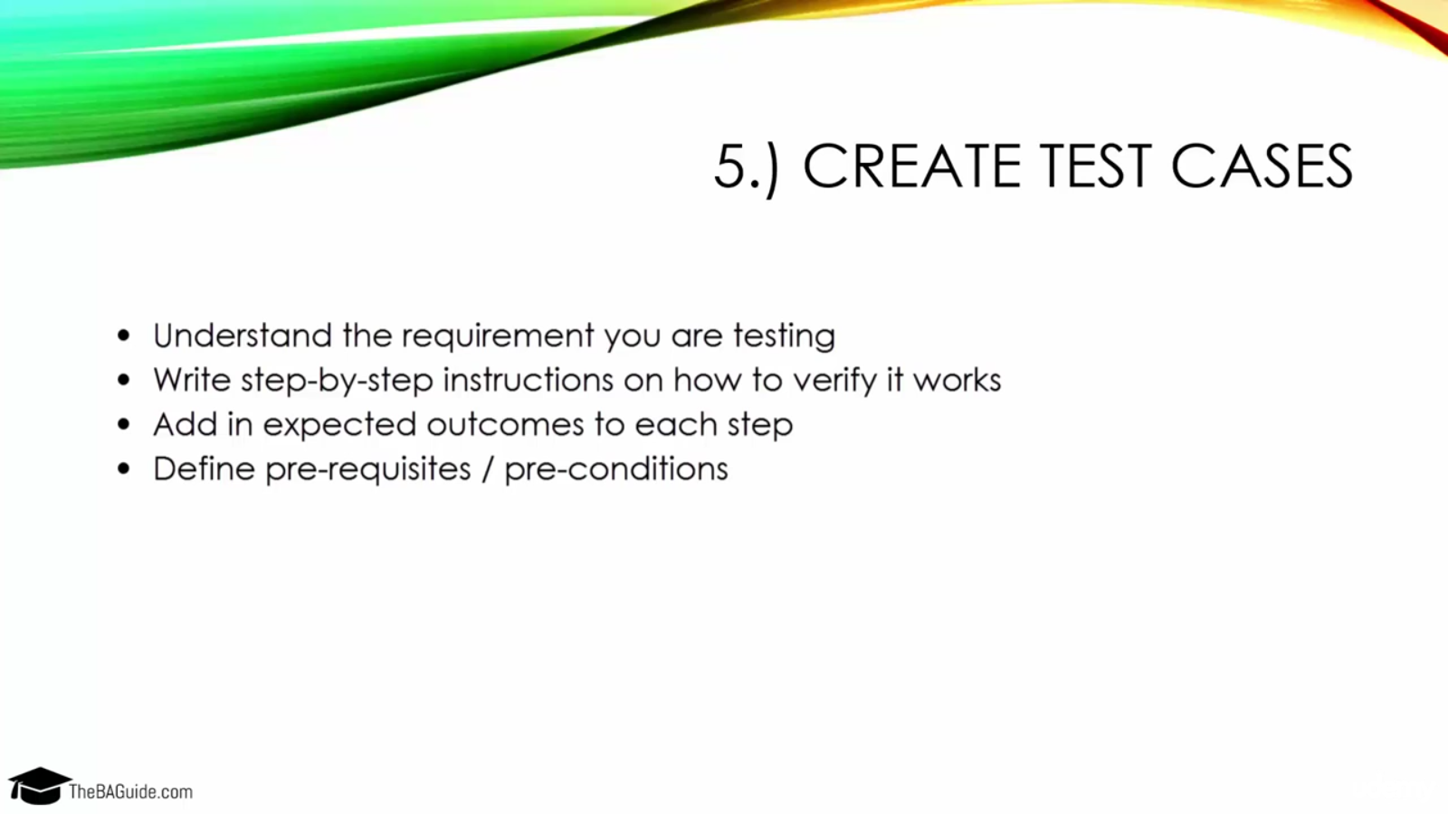
5.) create test cases

Slide 8
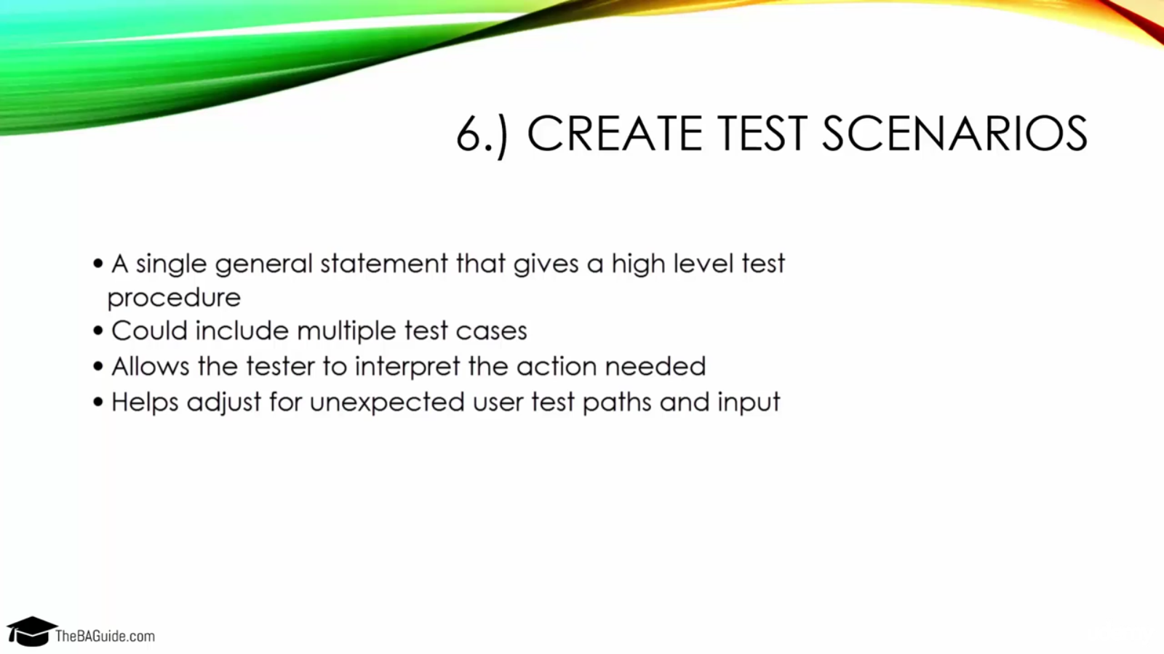
6.) Create test scenarios

Slide 9
7.) Execute testing phases
Integration and System Testing
Get any other testers up to speed (divide work as applicable)
Work through test workbook, validating each test case
Document any defects or bugs you find
Include notes, screenshots, and steps to recreate the issue
Assign identified defects to necessary resources
Re-test defects as they are resolved
(optional) Work through full document again to ensure all test cases pass
Or delegate this task to another person to get more perspective

Slide 10
7.) Execute testing phases
User Acceptance Testing
Demo the software to the business users
Explain the test workbook and test scenarios
Review the defect tracking software / medium
Walk through the instructions you created
Provide timeline for testing and create check-in points
Validate any defects that are entered
Assign validated defects to necessary resources
Ensure identified defects are resolved

Slide 11
7.) Execute testing phases
User Acceptance Testing (cont.)
Periodically discuss with Project Sponsor, and other key project team members, the state of the software and open defects
Identify what needs to be resolved before go live date and if feasible
Final Testing
(optional) Work through full document again to ensure all test cases pass
Or delegate this task to another person to get more perspective

Slide 12
8.) gain business approval
Not always feasible to resolve all defects before the go live date so the business needs to be brought in to make the decision
You (or the PM) setup a Go Live Decision meeting 2-3 days before the go live date
Review state of the software and any open defects
Judge risk to launch with defects and make recommendation
Launch as planned or delay launch date to fix specific defects
Execute on the determined plan

